Slide 1
PHOTOLITHOGRAPHY
Photolithography

Slide 2
PHOTOLITHOGRAPHY
Overview
PROCESS INTRODUCTION
LITHOGRAPHY PROCESS
INSPECTION
Photolithography

Slide 3
Overview
OXIDE
POLY
DEPOSITION
Poly
RESIST
APPLICATION
Resist
Poly
Photolithography

Slide 4
UV LIGHT
EXPOSURE
MASK/RETICLE
Resist
Poly
Resist
DEVELOP
Poly
Resist
ETCH
Poly
Photolithography

Slide 5
Resist Strip
Poly
Photolithography

Slide 6
Introduction
Process is carried out in the ‘yellow room’ as white light will expose the resist
  The UV element of white light
Environmental conditions (temperature, humidity) are carefully controlled
  Humidity in particular affects adhesion of the resist
Very clean processing conditions (class 10 or better) are required as any defects on the reticle will be printed on every field
  With a mask on every wafer
Photolithography

Slide 7
PHOTORESIST
Light sensitive material which is spun on wafer surface
Photoresist is exposed and developed during the photolithography process to generate the final image
Two Types of Resist
  POSITIVE RESIST -Exposed areas of resist are removed during the develop step
  NEGATIVE RESIST -Unexposed areas of resist are removed during the develop step
Photolithography

Slide 8
POSITIVE PHOTORESIST
Resin based polymer containing a photoactive compound (PAC)
Resists used in IC manufacturing are in liquid form.
There are Three main components
  DQN materials ((Diazoquinones)
  Novalak, an organic resin
  Solvents
The first two are Photoactive Compounds (PAC)
Photolithography

Slide 9
POSITIVE RESIST
The DNQ prevents dissolution of the Novalak resin in developer
When exposed to UV radiation the chemical structure of the DNQ changes and becomes soluble in developer solution
Unexposed areas of resist are also soluble (barely) in developer solution. Difference in develop rates between exposed and unexposed areas is ~1000:1
Photolithography

Slide 10
POSITIVE RESIST
Positive resist used in all small geometries (<3 Microns)
Resist profiles of 90º are possible
1 µm
Photolithography

Slide 11
Lithography Process
Dehydrate Bake
Surface Prime
Resist Spin
Soft Bake
Exposure
Post Exposure Bake
Develop
Hard Bake
Inspect
Photolithography

Slide 12
Equipment Layout
Hard Bake Develop Cup Post Exposure Bake
Load
Unload
Stepper/Aligner
Load
Unload
HMDS Prime Spin Cup Soft Bake
Photolithography

Slide 13
1 DEHYDRATE BAKE
Moisture on wafer surface will affect adhesion of the resist to the wafer
Wafers are baked at ‘high temperatures’ (250ºC) for up to 30 minutes
Vacuum ovens can also be used as water boils at a lower temperature under vacuum
Photolithography

Slide 14
2 HMDS PRIME
Hexamethyldisilizane is used as an adhesion promoter between the resist and the wafer
N₂ is bubbled through a reservoir of HMDS. HMDS vapour is carried to the wafer which sits on a hot plate
Hot plate temperature of >200ºC are required
Must be followed by a cool step prior to resist application
Photolithography

Slide 15
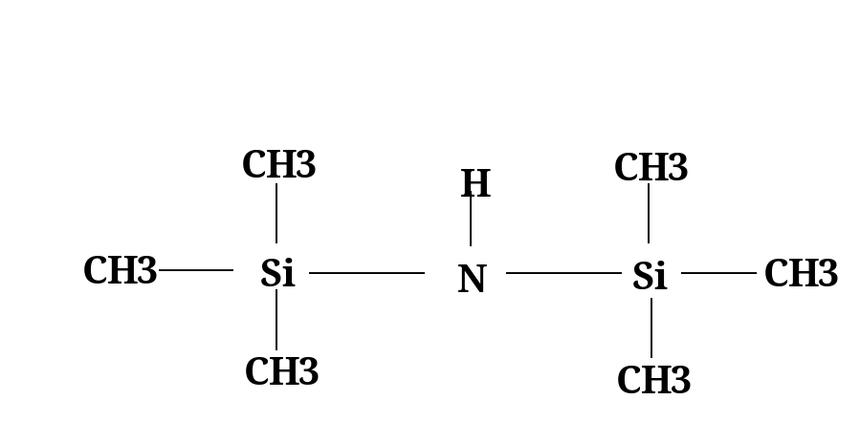
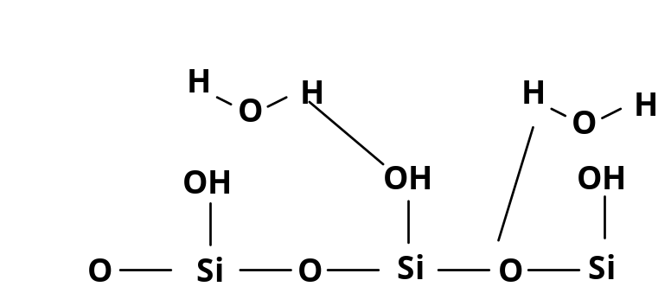
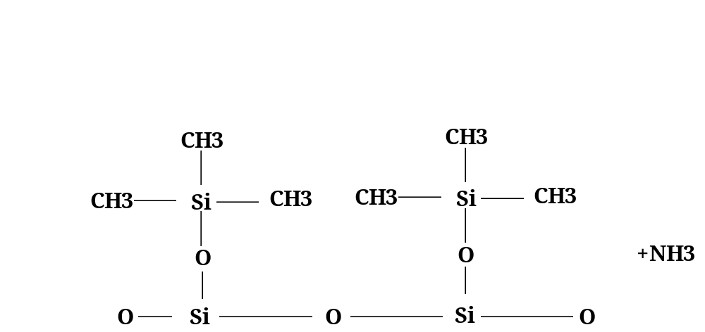
HMDS Prime
HMDS Chemical Configuration
Silicon Dioxide surface with OH
groups attached (Water )
HMDS Displaces the OH
and bonds to the silicon
surface and in turn to the
Photoresist
Photolithography

Slide 16
HMDS PRIME EQUIPMENT
HMDS
WAFER
HOT PLATE
HMDS
FLASK
N2 SUPPLY
Photolithography

Slide 17
3 RESIST APPLICATION
Dispense Nozzle
Exhaust
Flow
Wafer
Catch Cup
Wafer
Chuck
Resist Drain
Photolithography

Slide 18
RESIST APPLICATION
Photoresist is dispensed in liquid form
The steps in a typical dispense program would be as follows
1. Spin wafer at 1000rpm
2. Dispense resist at center of wafer for two
seconds
3. Accelerate to 5000 rpm and spin at
5000rpm for thirty seconds
Photolithography

Slide 19
RESIST APPLICATION
Typical resist thickness after spin is 1-1.2 microns
Resist thickness is determined by final spin speed
Uniformity of resist layer is usually better than 10nm across the wafer
Environment around the wafer must be tightly controlled
Photolithography

Slide 20
RESIST THICKNESS
1.5
1.4
1.3
1.2
1.1
1.0
Resist
Thickness
(µm)
3000 4000 5000 6000 7000
Spin Speed (rpm)
Photolithography

Slide 21
ENVIRONMENTAL CONSIDERATIONS
Environmental conditions must be maintained at a constant level
  humidity
  temperature
  spin cup exhaust
  room cleanliness
Photolithography

Slide 22
EDGE BEAD REMOVAL (EBR)
After resist spin solvent is applied to wafer edge to remove the edge bead
Edge bead can cause particle generation in later processing steps
Photolithography

Slide 23
WAFER EDGE EXPOSURE
Other possibility is a Fibre optic based system
UV light used to expose areas of the wafer to be clamped in the following processing stage
Resist in these areas is developed off during the normal develop process
Photolithography

Slide 24
4 SOFT BAKE
Removes solvents from the resist prior to exposure
Normally done on a hot plate at temperatures from 80ºC to 100ºC
Photolithography

Slide 25
5 EXPOSURE
Resist is exposed using a UV light source through a reticle or mask which contains the pattern to be exposed
Exposure tools commonly used include
  contact aligners
  projection aligners
  steppers
Photolithography

Slide 26
CONTACT/PROXIMITY ALIGNERS
Lamp
Minimum Resolution
≈ √gλ
Lens
UV Light
Mask
Gap
Wafer
Chuck
Y
Ø
X
Photolithography

Slide 27
MASKS
Reticle
Reticle pattern stepped
and reduced across the
mask plate
Mask
Fig 4 The mask making sequence.
Photolithography

Slide 28
MASKS
Quartz or glass plate with pattern etched in chrome surface
Pattern is repeated many times over mask
Single exposure step used to expose the pattern over the entire wafer
Photolithography

Slide 29
PROJECTION ALIGNERS
Wafer
Concave Mirror
Slit
Lens/Prism
Lens/Prism
Optics
Optics
Lamp
Mask
Photolithography

Slide 30
STEPPERS
Optics
5 or 10X Stepper
Configuration
Lamp
Reticle
Reduction Optics
X
Wafer
Stage
Y
Photolithography

Slide 31
RETICLE
Pattern Generation
Reticle used to make masks
or directly on the wafers on
a DSW (stepper) system
CAD Tape
Photolithography

Slide 32
RETICLES
Used with stepper exposure systems
Single pattern etched in chrome on reticle using e-beam direct write system
Wafer moves underneath reticle and each field is exposed individually
5x reduction steppers - image on reticle is 5 times bigger than on wafer
1x steppers -image size on reticle is same as on wafer
Photolithography

Slide 33
RETICLES
Reticles are pellicised
Thin membrane positioned over chrome surface
Particles deposited on membrane surface will be out of focus
Particle image will not be printed on wafer
Photolithography

Slide 34
Exposure Parameters
Exposure wavelength
Resolution
Depth of Focus
Exposure Energy
Photolithography

Slide 35
Exposure Wavelength
Exposure tools can use either broadband or monochromatic UV light sources
Shorter wavelengths used for smaller geometries
  I-line exposure 365nm (0.35 µm)
  G-line exposure 436nm (0.6 µm )
  Broadband exposure (0.8 µm)
Photolithography

Slide 36
Deep Sub-Micron Exposure
Deep sub-micron processes use laser exposure systems - from the ITRS Roadmap
  180nm-130nm node uses KrF laser with λ=248nm
  130nm-100nm node uses/will use ArF laser with λ =193nm
  100nm-70nm node will use the F₂ laser (under development) with λ =157nm
  For the 50nm node no laser available
Photolithography

Slide 37
MERCURY LAMP SPECTRUM
i line
Light
Intensity
365 nm
405 nm
436 nm
Wavelength
Photolithography

Slide 38
Resolution
Numerical aperture -light gathering capability of a lens
Mask
Wafer
NA=D/2f
D
2f
Photolithography

Slide 39
Resolution
Resolution (R)
  Minimum resolvable linewidth that can be printed
  R α(0.5) λ/ NA
Shorter wavelengths give smaller resolution
R
Photolithography

Slide 40
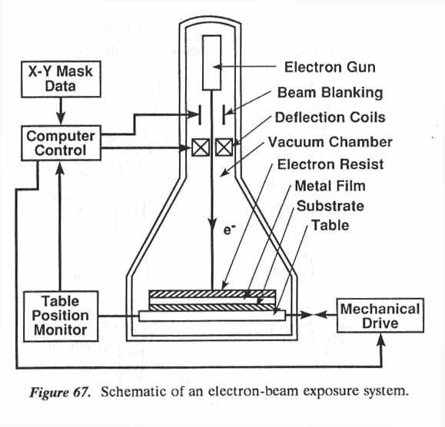
Electron Beam Lithography
Instead of using light a beam of electrons is used to directly write patterns into resist
Effective wavelength λ=h/mv
  where h= Planck’s constant
  m=mass and v=velocity
At 10keV effective wavelength is 0.012nm
Most modern E-Beam systems operate at energies of 50-100keV
Photolithography

Slide 41
Depth of Focus
In some photographs some objects are perfectly
in focus or have a sharp image, objects either closer or
further away than the focus point may be fuzzy.
Photolithography

Slide 42
Depth of Focus
Top of
Focus
Depth of
Poly
Resist
Focus
Oxide
Bottom
of Focus
Because of different step heights on wafers the optical system must have a wide
depth of focus.
Photolithography

Slide 43
DEPTH OF FOCUS
Depth of focus (DOF)
DOF α λ/2(ΝΑ) ²
Shorter wavelengths result in reduced DOF
Photolithography

Slide 44
Exposure Energy
UV Light
Resist bleaches
as light is
absorbed
Under exposed
Results in
Residual Resist
Over Exposed
Poor profile
CD error
Photolithography

Slide 45
Exposure Energy
CD VARIATION DUE TO EXPOSURE ENERGY
1.2
1.1
1.0
0.9
0.8
LINEWIDTH
100mj 120mj 140mj 160mj 180mj 200mj
EXPOSURE ENERGY
Photolithography

Slide 46
EXPOSURE LATITUDE
All lines measured from 1.0µm
line on the reticle
E=ENERGY TO PRINT 1.0µm
E1=ENERGY TO PRINT 1.1µm
E2=ENERGY TO PRINT 0.9µm
Exposure =(E2-E1)/E
Latitude
    =(190-105)/135
    =60%
1.2
1.1
1.0
0.9
0.8
CD µm
E1
E
E2
100 120 140 180 200
      Exposure Energy mj
Photolithography

Slide 47
E0 PROCESS MONITOR
E0 - energy required to clear resist
Plot log exposure energy v normalized resist thickness
E0 is the intersection of the line with the x axis
Photolithography

Slide 48
E0 Process Monitor
1.0
Thickness of
Resist
Remaining (μm)
Eo
0
LOG E
Photolithography

Slide 49
Equipment Layout
Hard Bake Develop Cup Post Exposure Bake
Unload
Stepper
Load
HMDS Prime Spin Cup Soft Bake
Photolithography

Slide 50
6 POST EXPOSURE BAKE
Wafer is baked after the exposure step
Typical process 120ºC for 60 seconds on a hot plate
Followed by cool step prior to develop
Used to reduce standing wave effects in exposed resist
Photolithography

Slide 51
Post Exposure Bake
EXPOSURE
POST DEVELOP
POST DEVELOP
No PEB
PEB
Photolithography

Slide 52
7 DEVELOPER
Alkaline based developer reacts with the exposed areas of resist
Resulting solution is rinsed off with a DI water rinse
Typical process
  Spray developer on wafer surface for 5 seconds
  Puddle develop for 60 seconds
  DI water rinse for 10 seconds
  Spin dry at 5000rpm for 15 seconds
Temperature of developer must be controlled to ensure constant develop rate
Photolithography

Slide 53
7 Developer Application
Dispense Nozzle
Exhaust
Flow
Wafer
Catch Cup
Wafer
Chuck
Developer Drain
Photolithography

Slide 54
8 HARD BAKE
Wafer is baked on a hot plate after develop
Typical process 120ºC for 60 seconds on a hot plate
Improves resist adhesion
Removes residual solvent from resist (important for high vacuum applications)
Improves thermal stability of the resist
Photolithography

Slide 55
9 Inspection
Resist Quality is inspected
  Ragged edges etc
Developed areas examined
  Incomplete develop/resist residue in developed areas?
Registration (or alignment accuracy) is measured
Critical Dimension (or linewidth) control is measured
Photolithography is one of the few processes in IC manufacturing that can be reworked
Photolithography

Slide 56
REGISTRATION
Alignment between each layer must be better that 0.1µm for a small geometry process (<1µm)
Alignment accuracy can be measured using dedicated measurement systems or using optical examination
Use vernier scales with microscope
Photolithography

Slide 57
VERNIER SCALE
-0.5 -0.4 -0.3 -0.2 -0.1
0 0.1 0.2 0.3 0.4 0.5
Photolithography

Slide 58
Future Developments
Optical lithography has continued to at least the 32nm node (ITRS Roadmap)
  In spite of initial fears that it would run out of resolution at geometries as large as 0.35μm (350nm)
A number of resolution enhancement techniques will have to be adopted (RET)
  Immersion Lithography
  Wavelength reduction
  Off-Axis Illumination (OAI)
  Phase Shift Masks (PSM)
  Optical Proximity Correction (OPC)
Photolithography

Slide 59
Critical Dimension
Linewidth or CD (critical dimension) is width of line as measured on the wafer
Resist CD is width of resist line printed on the wafer
Polysilicon CD is width of poly rail as measured after etch and resist strip
Important that measured CD is equal to dimension drawn on the reticle
Photolithography

Slide 60
CD MEASUREMENT
Optical based systems used for large (>1.0µm) processes
SEM based systems used for small geometry (<1.0µm) processes
Photolithography

Slide 61
Photolithography Summary
Transfer of patterns from photomasks/reticles to wafer surface
Largest single element of IC fabrication costs ----35%
Most sensitive to particle contamination - yield loss
Most sensitive to cleanroom conditions
High degree of focus in ITRS roadmaps
Photolithography

